Slide 1
Private-Key Encryption

Slide 2
Last Time
Introduction
What is information security?
Why is information security important?
Why is information security hard?

Slide 3
Last Time
Security mindset
Security should be part of a system to begin with, NOT an afterthought
Think of how the system can be attacked
Precisely define security goals
Use proper tools to achieve the security goals, i.e. defend the system against anticipated attacks

Slide 4
Last Time
Basic Goals of Information Security
Confidentiality – Hide confidential data
Integrity – Prevent unauthorized change of data
Availability – Make service available to intended users

Slide 5
Today
Encryption as a tool for confidentiality
Private-Key Encryption
Also known as Symmetric-Key Encryption

Slide 6
Encryption as a Tool for Confidentiality

Slide 7
Encryption
An encryption scheme has a pair of algorithms (or functions)
An encryption algorithm (function)
A decryption algorithm (function)
Encryption converts original data (called plaintext) into ciphertext ; Decryption is the reverse process
The ciphertext, instead of the plaintext (i.e. the original data), is transmitted or stored

Slide 8
Encryption & Decryption
Encryption
Decryption
Plaintext
Enc
Ciphertext
Plaintext
Dec
Ciphertext

Slide 9
Encryption & Decryption
The ciphertext supposedly hides information of the plaintext from unauthorized users
Yet using the decryption function, an authorized user can recover the plaintext from the ciphertext
How is this possible?
Answer: Encryption & decryption must reply on some secret information, called a key, that is only possessed by authorized users & hidden from unauthorized users

Slide 10
Encryption & Decryption
Encryption
Decryption
Encryption Key
Plaintext
Enc
Ciphertext
Decryption Key
Plaintext
Dec
Ciphertext

Slide 11
Two Paradigms for Encryption
Private-Key Encryption
The same key is used for encryption & decryption
Also known as symmetric-key encryption
Public-Key Encryption
The encryption key & decryption key are different
Also known as asymmetric-key encryption

Slide 12
Private-Key Encryption

Slide 13
Private-Key Encryption
Also known as symmetric-key encryption
A private (or secret) key, used for both encryption & decryption, is randomly generated and secretly stored

Slide 14
Private-Key Encryption
Encryption
Decryption
Key
Plaintext
Enc
Ciphertext
Key
Plaintext
Dec
Ciphertext

Slide 15
Private-Key Encryption
The private key needs to be shared in advance among authorized users
Nontrivial!! Will discuss key exchange later…

Slide 16
Some Notations
E: encryption algorithm (function)
D: decryption algorithm (function)
K: private key for both encryption & decryption
M: plaintext
C: ciphertext
E_{K}(M): ciphertext resulting from encryption of M with K
D_{K}(C): plaintext resulting from decryption of C with K

Slide 17
Private-Key Encryption
Encryption
Decryption
K
M
E
C = E_{K}(M)
K
M = D_{K}(C)
D
C

Slide 18
Private-Key Encryption
Correctness: D_{K}(E_{K}(M)) = M
I.e. when a key is used to encrypt a message and the same key is used to decrypt the resulting ciphertext, one recovers the original message
Have not said anything about security yet…

Slide 19
Principle of Open Design
The security of a mechanism should not depend on the secrecy of its design or implementation.
The security algorithms (e.g. encryption & decryption algorithms), and even the source code, should be publicly known
The secret key being the only thing kept secret

Slide 20
Application: Secure Communication
The private key K is shared between Alice & Bob
Alice encrypts a message M into a ciphertext C = E_{K}(M), then sends C to Bob
Bob, with the same key, decrypts C and recovers M by
D_{K}(C) = D_{K}(E_{K}(M)) = M
C
Alice
Bob
C = E_{K}(M)
M = D_{K}(C)
Attacker

Slide 21
Application: Secure Storage
A user generates a private key & safeguards it
Each file is encrypted with the key; the ciphertext is stored
Attacker cannot read a file without the key
The user, with the key, can read any file by decrypting its ciphertext

Slide 22
An example of private-key encryption

Slide 23
Shift Cipher
Also known as Caesar cipher
Message M = M₁ M₂ … M_{n} . For simplicity assume each symbol M₁, …, M_{n} is a character in {A, …, Z}.
Can be easily adapted to handle arbitrary alphabets
Key Generation: Choose a random number K from {0, … , 25}

Slide 24
Shift Cipher (cont’d)
Encryption: Shift each symbol of M by K positions down the alphabet, wrapping around if necessary
E.g. the ciphertext of “HELLO WORLD”, with K = 4, is “LIPPS ASVPH”
Decryption: Reverse process of encryption, i.e. shift each symbol of M by K positions up the alphabet

Slide 25
Is Shift Cipher Secure?
The shift is the same for all plaintext symbols
Relative alphabet positions of plaintext symbols is preserved in the ciphertext. For example
If the ciphertext is XYZ, then its plaintext is one of the 26 possibilities: ABC, BCD, CDE, …
If the ciphertext is TEE, then its plaintext is one of the 26 possibilities: ALL, BMM, CNN, …

Slide 26
Is Shift Cipher Secure?
No!!!
Ciphertext yields lots of patterns about the plaintext
Can usually be completely broken because valid messages are typically sparse in a context
For instance:
Citizens vote for one of the two presidential candidates
The message is written in English (or any natural language)

Slide 27
How to Break Shift Cipher
Most combinations of symbols from the alphabet do not form meaningful words, phrases or sentence
The key space is small
# keys = size of alphabet which is small
Simply try all possible keys to decrypt a ciphertext
Only few keys (typically one) would yield a plaintext that is meaningful

Slide 28
Substitution Cipher – Another Insecure Cipher
Private key describes a mapping that randomly maps each plaintext letter to a unique ciphertext letter
For instance, if the mapping is A → E, B → T, C → A, …, then “ETA” is the ciphertext of the plaintext “ABC”
Share some drawbacks of the Shift Cipher
Each symbol for the plaintext is always mapped to the same symbol for the ciphertext once the key is determined
A symbol repeats in the ciphertext if and only if a symbol repeats in the plaintext

Slide 29
Substitution Cipher – Another Insecure Cipher (cont’d)
Can no longer try all possible keys in order to break it because the key space is now very large
But can break it by frequency analysis
There are many other insecure ciphers like the substitution cipher …

Slide 30
Question: How can we construct a secure private-key encryption scheme? And what does security mean?

Slide 31
What can the attacker do?
Consider for now a passive attacker who can only intercept data
The attacker
Captures the ciphertext
But does not have the private key
Wants to learn the message (plaintext) from the ciphertext only

Slide 32
How powerful is the attacker?
Unbounded attacker (theoretical & imaginary)
Has unlimited computing resources
Security against unbounded attackers is ideal, but usually too much to ask
Bounded attacker (realistic)
Can still be very powerful but is limited in computing resources, e.g. CPU speed, memory space, etc.
In reality, every attacker is limited in some way

Slide 33
Shannon’s Perfect Secrecy
Claude Shannon, 1949
Father of information theory
Shannon’s ambitious goal: Security against unbounded attackers

Slide 34
Shannon’s Perfect Secrecy
An encryption scheme satisfies perfect secrecy if
The ciphertext E_{K}(M) has no statistical correlation with the plaintext M
I.e. for any ciphertext, its plaintext is equally likely to be any possible message
Thus the ciphertext contains no information about the plaintext

Slide 35
Shannon’s Perfect Secrecy
Shannon’s perfect secrecy implies security of encryption against unbounded attackers
Since the ciphertext contains no information about the plaintext
Even exhausting all possible keys does not help

Slide 36
One-time Pad Scheme
Notation: ⊕ denotes exclusive-or (XOR), i.e.
0 ⊕ 0 = 1 ⊕ 1 = 0
0 ⊕ 1 = 1 ⊕ 0 = 1

Slide 37
One-time Pad Scheme
Let M = M₁ M₂ … M_{n} be the message
n is the bit length of the message
M_{i} is the i-th bit of M
Key Generation
An n-bit private key K, known as a one-time pad, is randomly generated; that is,
K = K₁ K₂ … K_{n} , where each bit K_{i} is randomly chosen; i.e. each K_{i} is 0 with probability ½ & 1 with probability ½

Slide 38
One-time Pad Scheme
Encryption
E_{K}(M) = M ⊕ K = (M₁ ⊕ K₁, M₂ ⊕ K₂, …, M_{n} ⊕ K_{n})
Decryption
E_{K}(M) ⊕ K = M ⊕ K ⊕ K = M

Slide 39
One-time Pad Encryption Example
M: 1, 1, 0, 0, 1, 1, 0, 1
K: 1, 0, 0, 1, 0, 0, 1, 1
E_{K}(M): 0, 1, 0, 1, 1, 1, 1, 0
39
Notes:
39

Slide 40
One-time Pad Decryption Example
M: 1, 1, 0, 0, 1, 1, 0, 1
K: 1, 0, 0, 1, 0, 0, 1, 1
E_{K}(M): 0, 1, 0, 1, 1, 1, 1, 0
40
Notes:
40

Slide 41
One-time Pad Decryption Example
M: 1, 1, 0, 0, 1, 1, 0, 1
K: 1, 0, 0, 1, 0, 0, 1, 1
E_{K}(M): 0, 1, 0, 1, 1, 1, 1, 0
D_{K}(E_{K}(M)): 1, 1, 0, 0, 1, 1, 0, 1
41
Notes:
41

Slide 42
Remark on Plaintext Length
Obviously, one-time pad encryption as described does not hide the length of the plaintext
plaintext length = ciphertext length
However, no encryption algorithm can hide the length of its input
To hide plaintext length, one typically applies randomized padding to the plaintext before encryption
42
Notes:
42

Slide 43
The Security of One-time Pad
One-time Pad encryption satisfies perfect secrecy if the one-time pad is used once
For any ciphertext, every message of the same length is equally likely to be its plaintext
43
Notes:
43

Slide 44
Example
Suppose that 01 is the ciphertext. What can its plaintext be?
The plaintext can be
00 if K = 01
01 if K = 00
10 if K = 11
11 if K = 10
Each of the 4 possibilities occurs with probability ¼

Slide 45
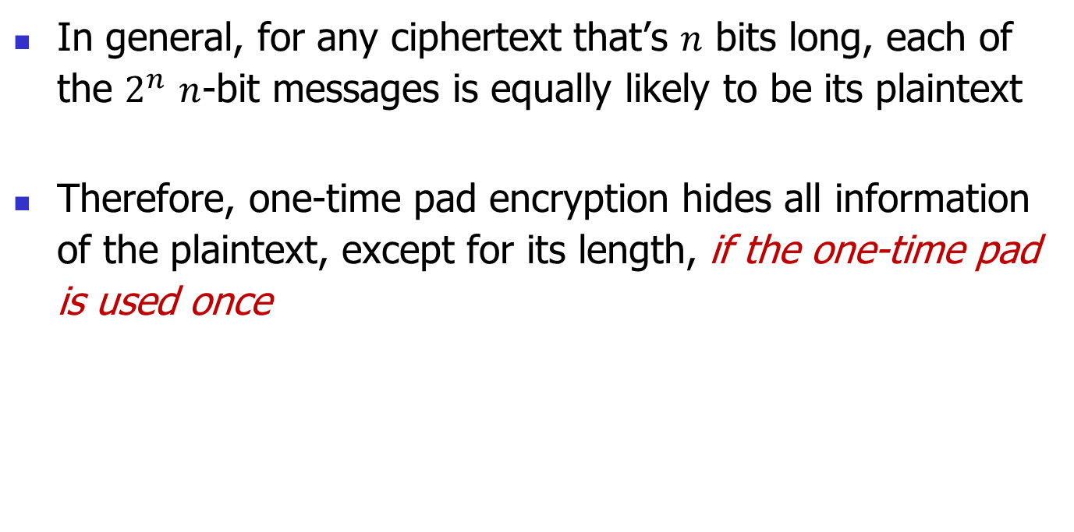
The Security of One-time Pad
In general, for any ciphertext that’s $n$ bits long, each of the $2^{n}$ $n$-bit messages is equally likely to be its plaintext
Therefore, one-time pad encryption hides all information of the plaintext, except for its length, if the one-time pad is used once
45
Notes:
45

Slide 46
Limitations of One-Time Pad
One-time pad can be used only once
Perfect secrecy no longer holds if the one-time pad is used twice
Re-using the one-time pad a few times leads to total break of the scheme
Thus need to establish a new key for each message
Key is long
Size of One-time Pad = Size of Message

Slide 47
Shannon’s Impossibility Result
To achieve perfect secrecy
Key must be as long as message
Key cannot be re-usable
Thus One-Time Pad is the best possible

Slide 48
Implications
Perfect secrecy is unrealistic
Security can be practically achieved only if the attacker is limited in some way

Slide 49
Modern Approach to Security
Choose a hard puzzle that no one knows how to solve using the state-of-the-art technology
Build a system based on the hard puzzle, so that to break the system one must solve the puzzle
The system remains secure relative to an attacker as long as the attacker cannot solve the puzzle

Slide 50
Modern Private-Key Encryption
Goals:
A short (say 256-bit) key re-usable for encrypting many long messages (say gigabits in total)
Hard for an attacker to learn information about the encrypted messages

Slide 51
Next Time
Overview of modern private-key encryption

